Slide 8
6

Slide 9
5

Slide 10
9

Slide 11
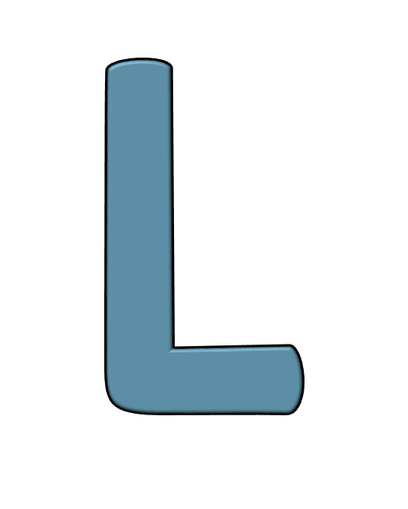

Slide 17
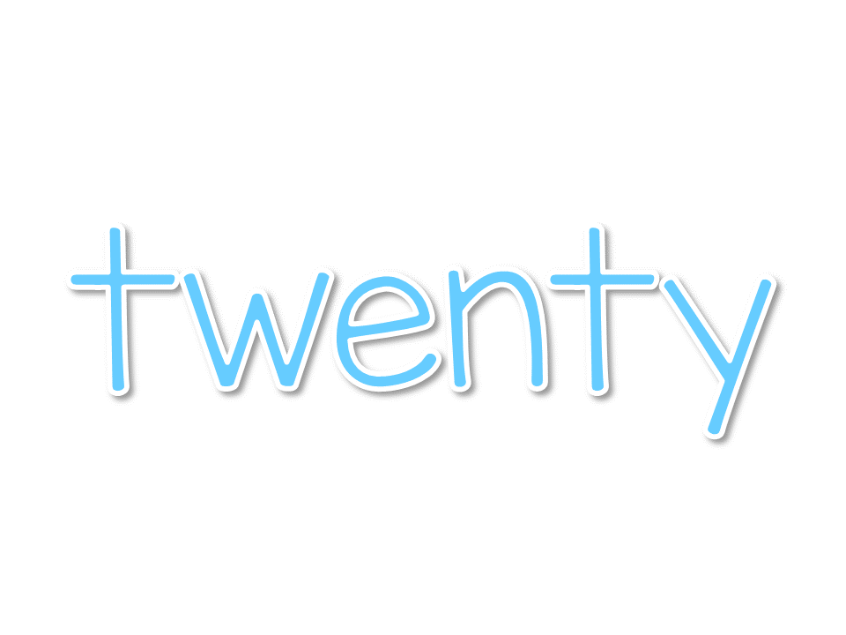

Slide 28
Question: Why is September 30 days long?
Source 1: | URL | Website Publisher or Author
Confirmed by: | URL | Website Publisher or Author
Answer:

Slide 34
https://scratch.mit.edu/

Slide 35
http://invention.si.edu/cloud-dreamer

