Slide 8
7
1
4
9
2
6
Teachers, there are 40 of each (pumpkin and acorn) on top of each other. If you want your students to have to copy and paste, simply delete all but one of each.

Slide 9
8
3
0
7
5
10
Teachers, there are 40 of each (pumpkin and acorn) on top of each other. If you want your students to have to copy and paste, simply delete all but one of each.

Slide 12
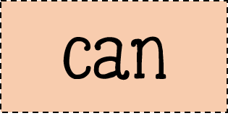
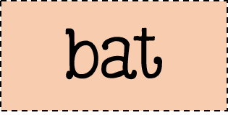
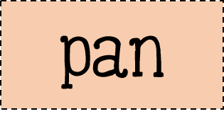
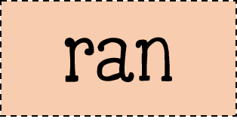

Slide 14
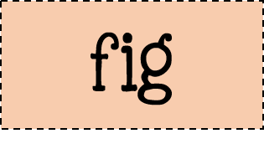

Slide 19
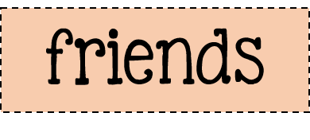
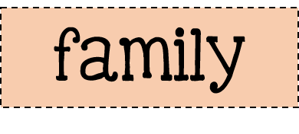
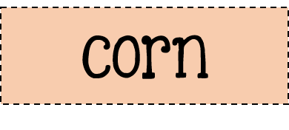
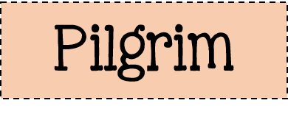
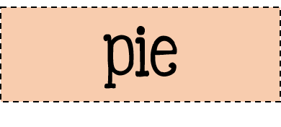
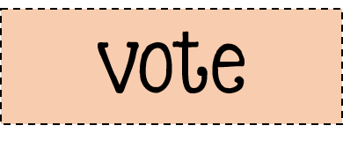

Slide 22
*Use the paint bucket tool
1 | 2 | 3 | 4 | 5 | 6 | 7 | 8 | 9 | 10
11 | 12 | 13 | 14 | 15 | 16 | 17 | 18 | 19 | 20
21 | 22 | 23 | 24 | 25 | 26 | 27 | 28 | 29 | 30
31 | 32 | 33 | 34 | 35 | 36 | 37 | 38 | 39 | 40
41 | 42 | 43 | 44 | 45 | 46 | 47 | 48 | 49 | 50
51 | 52 | 53 | 54 | 55 | 56 | 57 | 58 | 59 | 60
61 | 62 | 63 | 64 | 65 | 66 | 67 | 68 | 69 | 70
71 | 72 | 73 | 74 | 75 | 76 | 77 | 78 | 79 | 80
81 | 82 | 83 | 84 | 85 | 86 | 87 | 88 | 89 | 90
91 | 92 | 93 | 94 | 95 | 96 | 97 | 98 | 99 | 100
101 | 102 | 103 | 104 | 105 | 106 | 107 | 108 | 109 | 110
111 | 112 | 113 | 114 | 115 | 116 | 117 | 118 | 119 | 120

Slide 29
In the psat, Thanksgiving celebrad the harvest, or the fud that was groun during the yeer. The havest was gathered in the fawl. So Thanksgiving is celebrated in the fall, too.
This cornucopia is a simbol of the harvest. It shoes fruits and vegetables that are gathered in a fall harvest.
Is Thanksgiving only celebrated in the United States?
Same other cowntries celebrate Thanksgiving, too. These are some of the plases around the world that celebrate Thanksgiving:
•Canada
•Liberia, a cotry in Africa
•Saint Lucia, a countre in the Caribbean
•Norfolk Island, a smaal island that is part of Australia
Often, these places celebrate Thanksgiving on a diffrent day. For example, people in Canada celebrate Thanksgiving on the secend Monday in October.

Slide 30
Question: Which U.S. President declared a Day of Thanksgiving?
Source 1: | URL | Website Publisher or Author
Confirmed by: | URL | Website Publisher or Author
Answer:

Slide 31
COACH

Slide 34
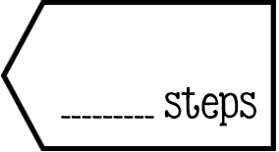

Slide 37
http://www.readwritethink.org/files/resources/interactives/timeline_2/

Slide 38
http://www.readwritethink.org/files/resources/interactives/acrostic/

