Slide 9
X
X

Slide 10
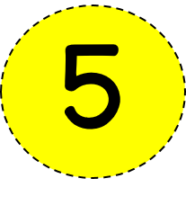
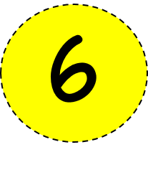

Slide 15
give | give | give | good | after | after | man | after | great | where
give | give | give | give | good | good | after | after | great | where
give | give | give | give | man | man | after | after | great | where
most | most | things | things | things | just | just | good | great | where
most | things | think | our | say | just | just | things | our | where
most | things | our | think | just | just | say | things | good | very
most | things | good | our | just | just | our | just | just | very
most | things | just | just | man | our | think | just | just | very
most | say | just | just | just | just | just | say | our | very
most | just | our | man | just | just | just | our | name | very
help | help | our | our | think | our | our | say | very | very
much | much | much | things | things | things | man | very | very | very

Slide 21
S C R I P T
*Tip: put 2 spaces between each letter to get them to line up with the boxes.

Slide 22
Question: What was the name of the battle for which Cinco de Mayo is now celebrated?
Source 1: | URL | Website Publisher or Author
Confirmed by: | URL | Website Publisher or Author
Answer:

Slide 26
3024 | 3024 | 3024 | 3024 | 3024 | 3024 | 3024 | 3024 | 3024 | 3024
3024 | 5664 | 5664 | 5664 | 3024 | 3024 | 3024 | 3042 | 3042 | 3042
3024 | 5664 | 5664 | 5664 | 3024 | 3024 | 3024 | 3042 | 3042 | 3042
3024 | 3024 | 5664 | 5664 | 3024 | 3024 | 3024 | 81 | 81 | 66
3024 | 3024 | 3024 | 16 | 16 | 16 | 81 | 3042 | 66 | 66
3024 | 3024 | 3024 | 3024 | 16 | 55 | 81 | 66 | 66 | 66
3024 | 3024 | 3024 | 55 | 6650 | 32 | 2150 | 2150 | 66 | 66
3024 | 3024 | 55 | 55 | 66 | 22 | 66 | 2150 | 2150 | 66
3024 | 6650 | 6650 | 66 | 66 | 22 | 66 | 66 | 32 | 32
3024 | 6650 | 6650 | 66 | 66 | 22 | 66 | 66 | 32 | 32
3024 | 6650 | 6650 | 66 | 66 | 2961 | 66 | 66 | 32 | 32
3024 | 66 | 66 | 66 | 66 | 2961 | 66 | 66 | 66 | 66
154 | ÷ | 7 | ₌ |  | Red
288 | ÷ | 9 | ₌ |  | Orange
330 | ÷ | 6 | ₌ |  | Yellow
648 | ÷ | 8 | ₌ |  | Green
462 | ÷ | 7 | ₌ |  | Blue
32 | ÷ | 2 | ₌ |  | Purple
47 | x | 63 | ₌ |  | Red
86 | x | 25 | ₌ |  | Orange
95 | x | 70 | ₌ |  | Yellow
78 | x | 39 | ₌ |  | Green
63 | x | 48 | ₌ |  | Blue
59 | x | 96 | ₌ |  | Purple

Slide 30
https://scratch.mit.edu/

Slide 31
http://invention.si.edu/cloud-dreamer

