Slide 11
9
6
4
12

Slide 23
1 | 2 | 3 | 4 | 5 | 6 | 7 | 8 | 9 | 10
11 | 12 | 13 | 14 | 15 | 16 | 17 | 18 | 19 | 20
21 | 22 | 23 | 24 | 25 | 26 | 27 | 28 | 29 | 30
31 | 32 | 33 | 34 | 35 | 36 | 37 | 38 | 39 | 40
41 | 42 | 43 | 44 | 45 | 46 | 47 | 48 | 49 | 50
51 | 52 | 53 | 54 | 55 | 56 | 57 | 58 | 59 | 60
61 | 62 | 63 | 64 | 65 | 66 | 67 | 68 | 69 | 70
71 | 72 | 73 | 74 | 75 | 76 | 77 | 78 | 79 | 80
81 | 82 | 83 | 84 | 85 | 86 | 87 | 88 | 89 | 90
91 | 92 | 93 | 94 | 95 | 96 | 97 | 98 | 99 | 100
101 | 102 | 103 | 104 | 105 | 106 | 107 | 108 | 109 | 110
111 | 112 | 113 | 114 | 115 | 116 | 117 | 118 | 119 | 120

Slide 30
Many peeple own ceel phones. Somtimes, people us their fhones to coll another pewson. Other times, people use their phones to send text mesages. Text messages are mad up of tiiped words. The messages ar sint from one cell phone to another.
Text messages re ofen shirt. Some people send text messages saing, “I am leiving now.” People who receive that kond of text may reply, “Okay. Se you soon.”
The first text mesage was sent on December 3, 1992. The message said, “Merry Christmas.”

Slide 31
Question: What was the most popular holiday toy in 1996?
Source 1: | URL | Website Publisher or Author
Confirmed by: | URL | Website Publisher or Author
Answer:

Slide 32
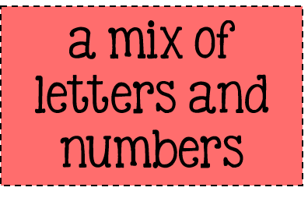

Slide 35
4
4
4
4

Slide 36
4
4
4
4

Slide 37
4
4
4
4

Slide 38
http://bit.ly/2y5EKzx

Slide 39
http://bit.ly/2y4F69C

